Slide 1

Decision Trees
INFO 6105

Slide 2
Problem Statement
Implement Decision Tree on Loan Dataset
Implement Random Forests on Loan Dataset

Slide 3
Technical Approach
Import Data excel
Process data
(Test – Train Split) [70, 30]
Create a function to output: Accuracy score, classification report, confusion matrix
Run DecisionTreeClassifier on the test and train samples
Hyperparameter Tuning: Gini index & Entropy
Visualization of a Tree
Implementing RandomForestClassifier

Slide 4
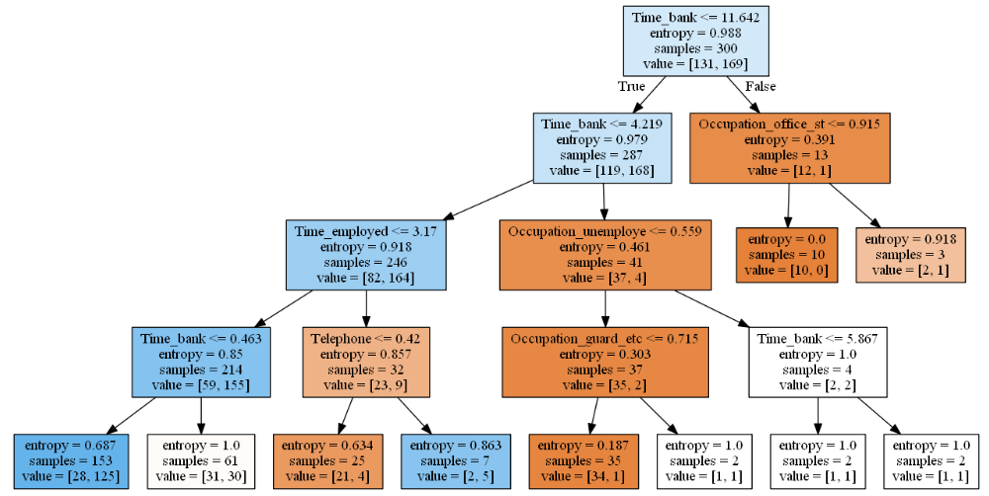
Results
DecisionTreeClassifier :
Accuracy Report:
Test – 100
Train – 66.67%
DecisionTreeClassifier (with Gini Index & Entropy) :
Accuracy Report:
Test – 79%
Train – 70.54%
RandomForestClassifier
Accuracy Report:
Test – 100%
Train – 75.97%

